Slide 1
Washington State Digital Archives
Multi-State Preservation Consortium
Ingestion and Indigestion
Presented by:
Kerry Barbour
&
Justin Jaffe
June 2009

Slide 2
Digital Archives Mission
The Washington State Digital Archives is the nation's first archives dedicated specifically to the preservation of electronic (born digital) records from State and Local agencies that have permanent, legal, fiscal or historical value

Slide 3
Digital WAC
434-662
Section 130 in effect as of January 2009. (For example, auditor and court records. )
Section 140 and 150 go into effective January 2010 – State Agencies are mandated to send electronic records to DA
  Archiving E-mail
  Archiving Websites

Slide 4
Technology Challenges
Data received in many different formats e.g., multiple auditor systems, Clerk of Courts, audio etc.
Data received from multiple customers: Minutes/Resolutions/Ordinances from Health Departments, Fire Districts, and County Auditors.
Different fees per partner agency
Rapid increase of records – sheer volume

Slide 5
Ingestion Capacity - Auditor Data
Indexes only with no images - Process 10,000 indexes per minute for a total of 14,400,000 indexes a day.
Indexes with one associated image - Process 1,600 images and indexes a minute for a total of 2,304,000 a day.
Indexes with four associated images - Process 400 images and indexes a minute for a total of 576,000 total records a day.

Slide 6
Washington Customers by Type

Slide 7
Records by Customer Type

Slide 8
Upcoming Projects
E-mail archiving
Develop tools to Spider Websites
Desktop Documents Archiving
  Provide for text search
Develop a redaction tool
  Internal and customer

Slide 9
Upcoming Projects
Disaster Recovery Exercise for DA
Automate ingestion process for Clerk of Courts and Auditors.
Redesign our Digital Archives Website
  – Customer centered.

Slide 10
Partners
Eastern Washington University
Microsoft
Library of Congress

Slide 11
The Demonstration
NDIIPP partnership between Washington and the Library of Congress began November 1, 2007.
Kickoff meeting for the first four partners in March 2008.

Slide 12
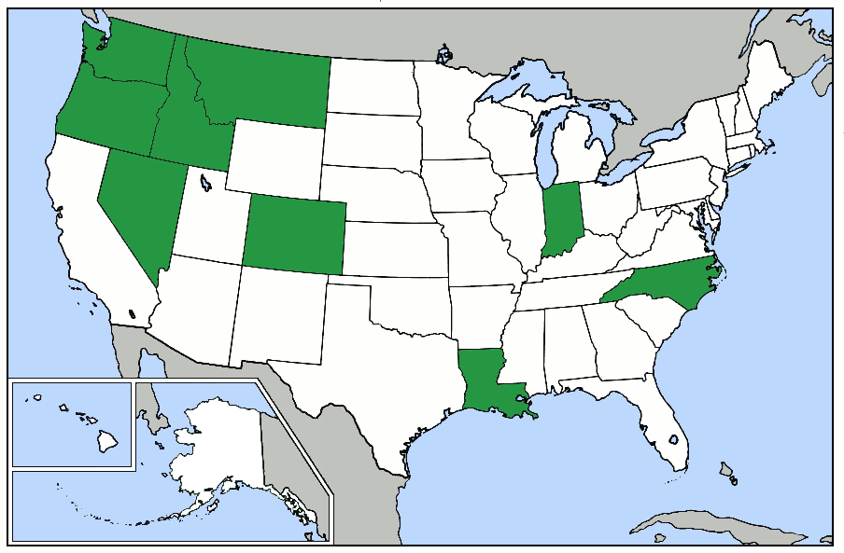
Who Are Our State Partners?
Colorado
Idaho
Indiana
Louisiana
Montana
Nevada
North Carolina
Oregon
Washington

Slide 13
Partner Records Online
June 2009

Slide 14
Total State Searches
June 2009

Slide 15
Internal Divisions - Indigestion
Communication and cooperation within the state agencies.
  Separation of interested between parties.
  DNS names.
Support within the state agencies.
  Sense of ownership.
    Network security
    Records are revenue

Slide 16
Internal Divisions - Solutions
Communication and cooperation within the state agencies.
  Misunderstanding
  Work as and intermediary to offer solutions.
Support within the state agencies.
  Mistrust
  Educate
    Watermark records “UNOFFICIAL”.
    Format hard drives.

Slide 17
Universal Standards - Indigestion
Metadata
  Previously digitized records
  OCLC
File formats
Record modification

Slide 18
Universal Standards - Solutions
Metadata
  Document our metadata requirements.
  Work with venders like OCLC and partners.
File formats
  Migratable
  Open format
  Industry standard
Record modification
  Done by partners

Slide 19
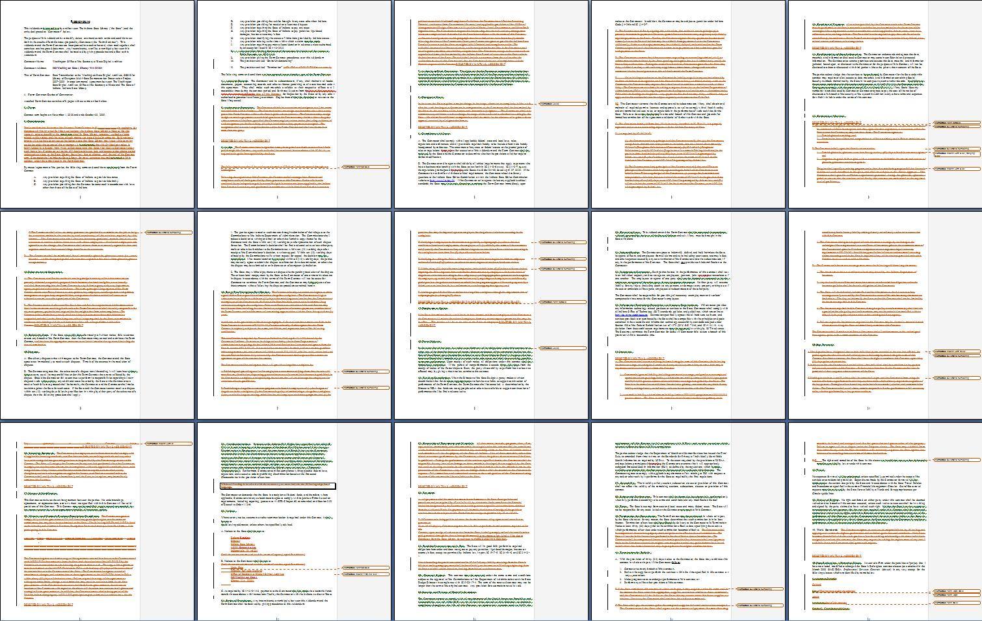
Legal Red Tape - Indigestion
State records being held out-of-state.
3 page agreement with partners.

Slide 20
Legal Red Tape - Solutions
State records being held out-of-state.
  Seamless integration (DNS names).
  Value of offsite backup.
3 page agreement with partners.
  Talk with attorneys from partner state.
    Demonstration project
    No money involved
    Short timeframe

Slide 21
Economic Downturn - Indigestion
Budget crisis in almost every state.
  Cutting costs
    Limit travel
    Cut back on projects
    Layoffs

Slide 22
Economic Downturn - Solutions
Budget crisis in almost every state.
  Encourage partners to hang in there.
  Remind partners there isn’t any cost to them to be a partner during the demonstration.

Slide 23
Questions?

Slide 24
Contacts
Jerry Handfield jhandfield@secstate.wa.gov
State Archivist (360) 586-2664
Kerry Barbour kbarbour@secstate.wa.gov
Digital Archivist (509) 235-7500 x 201
Justin Jaffe jjaffe@secstate.wa.gov
Ingestion Coordinator (509) 235-7500 x 224

Slide 25
Record Count
Records added since January 2008: 57,871,616

Slide 26
Record Series Count

